Slide 1

A PROJECT
ON
WEATHER PREDICTION
BACHELOR OF TECHNOLOGY
IN
COMPUTER SCIENCE AND ENGINEERING
BY
ADARSH P R 23VE1A05k3
MALOTHU SIDDHU 23VE1A05N0
VALLURI NAGESHWARI 23VE1A05R3
ENJETI DEEPTHI 24VE5A0521
ACADEMIC BATCH: 2023-2027
Under the Guidance of
Mr. M. Hari Prasad

Slide 2
CONTENT ________________________________________________
Modules
User module
Data collection module
Prediction module
Admin module
Class Diagram
Use case Diagram
Activity Diagram

Slide 3
MODULES : ________________________________________________
Allows users to:
Enter location (e.g., Hyderabad).
View current and predicted weather.
Access basic visualizations (e.g., temperature trends).
Validates input and interacts with the backend ML model.
1. User Module
2. Data Collection Module
Gathers historical weather data from CSVs or APIs (like OpenWeatherMap).
Handles data cleaning, preprocessing, and storage.
Supports both local CSV and live data sources.

Slide 4
3. Prediction Module
Trains and evaluates machine learning models.
Uses features like humidity, pressure, and wind speed to predict temperature.
Visualizes actual vs. predicted results.
4. Admin Module
Manages dataset uploads and model retraining.
Allows manual update of data, model parameters, and configurations.
Secured access for developers or analysts.

Slide 5
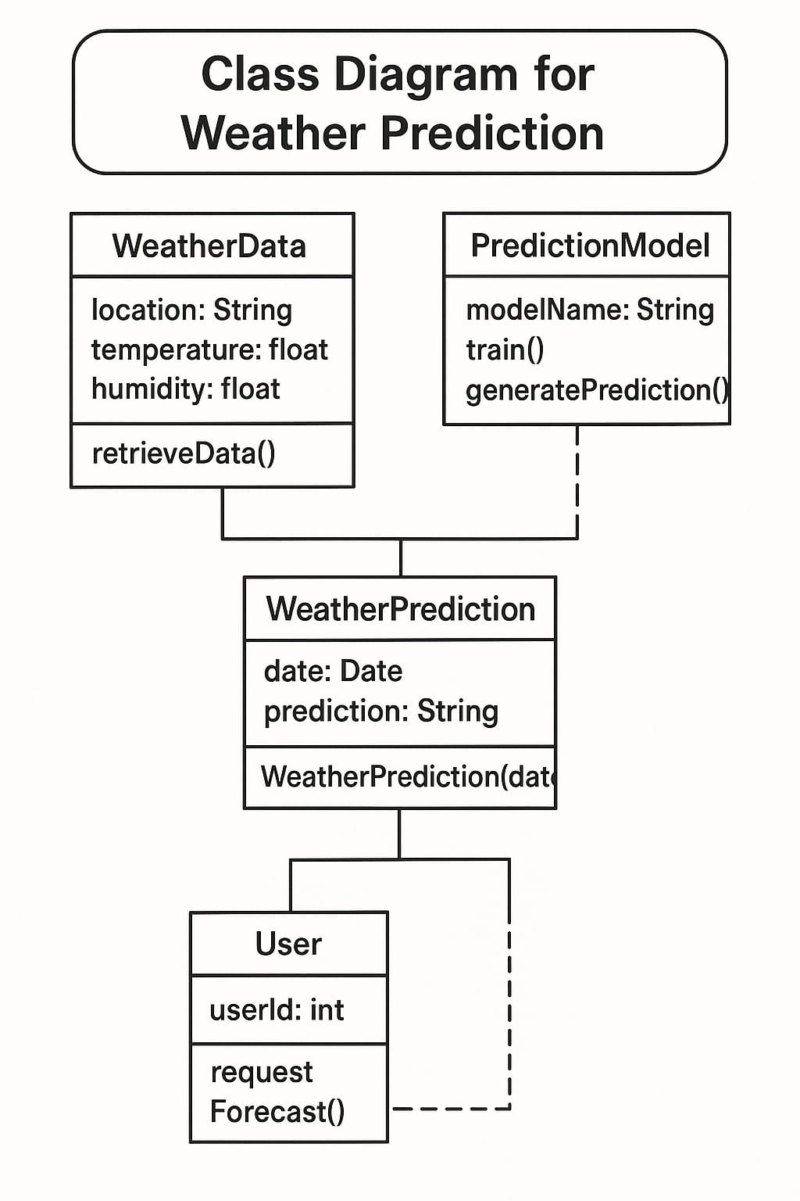
Class diagram: ________________________________________________

Slide 6
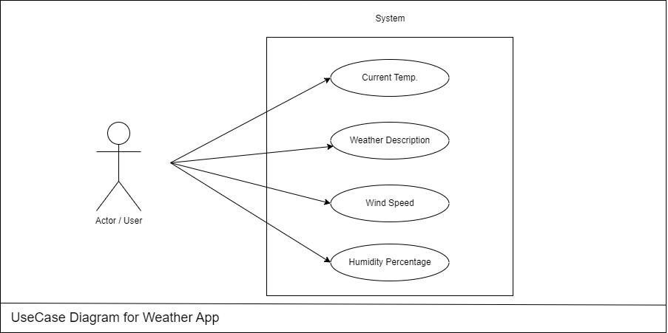
Use case diagram: ________________________________________________

Slide 7
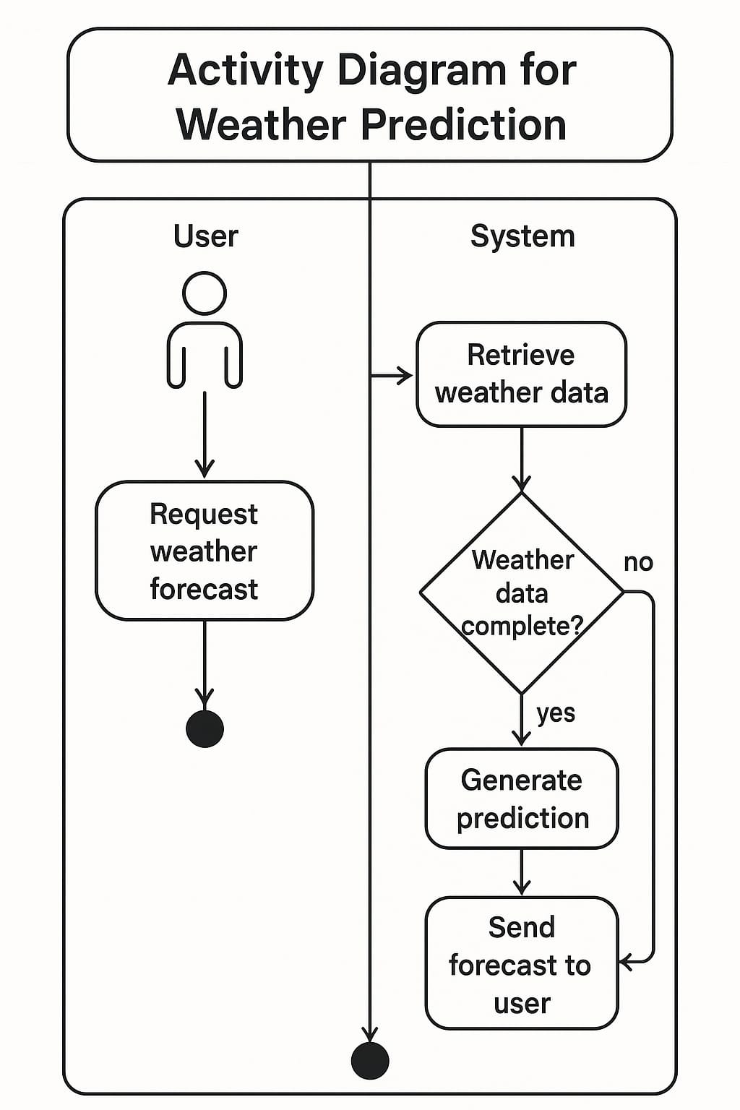
Activity Diagram: ________________________________________________

